Slide 1
covid-19-countries-aggregated-part2
File created on: 31-03-2020 20:12:24

Slide 2
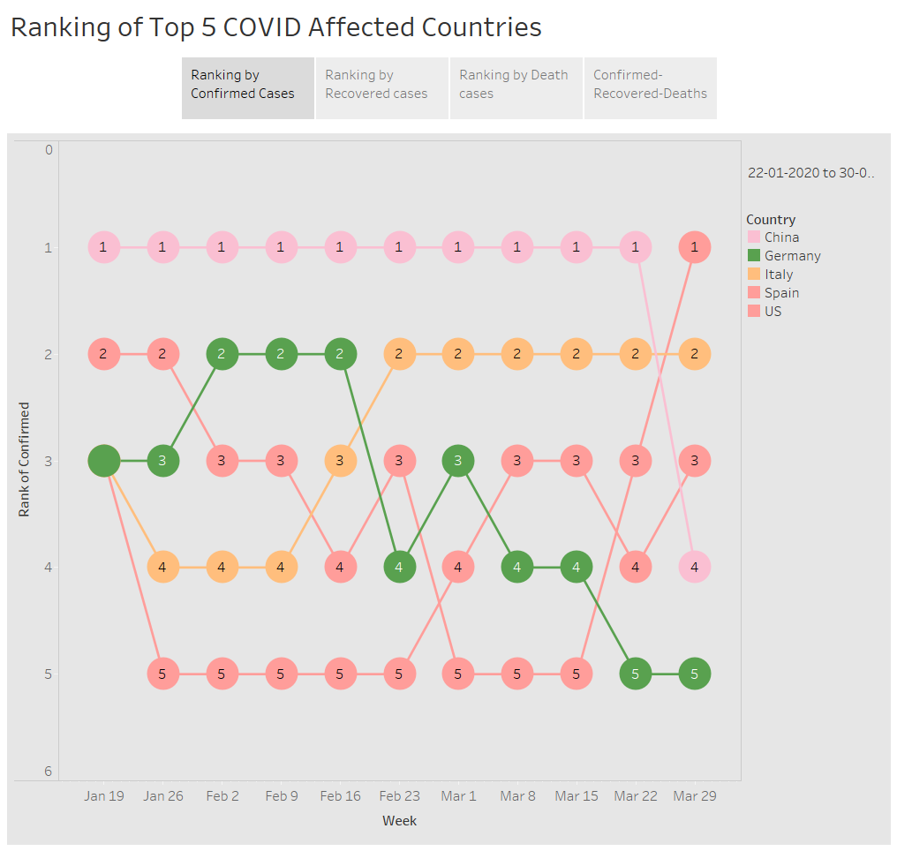

Slide 3
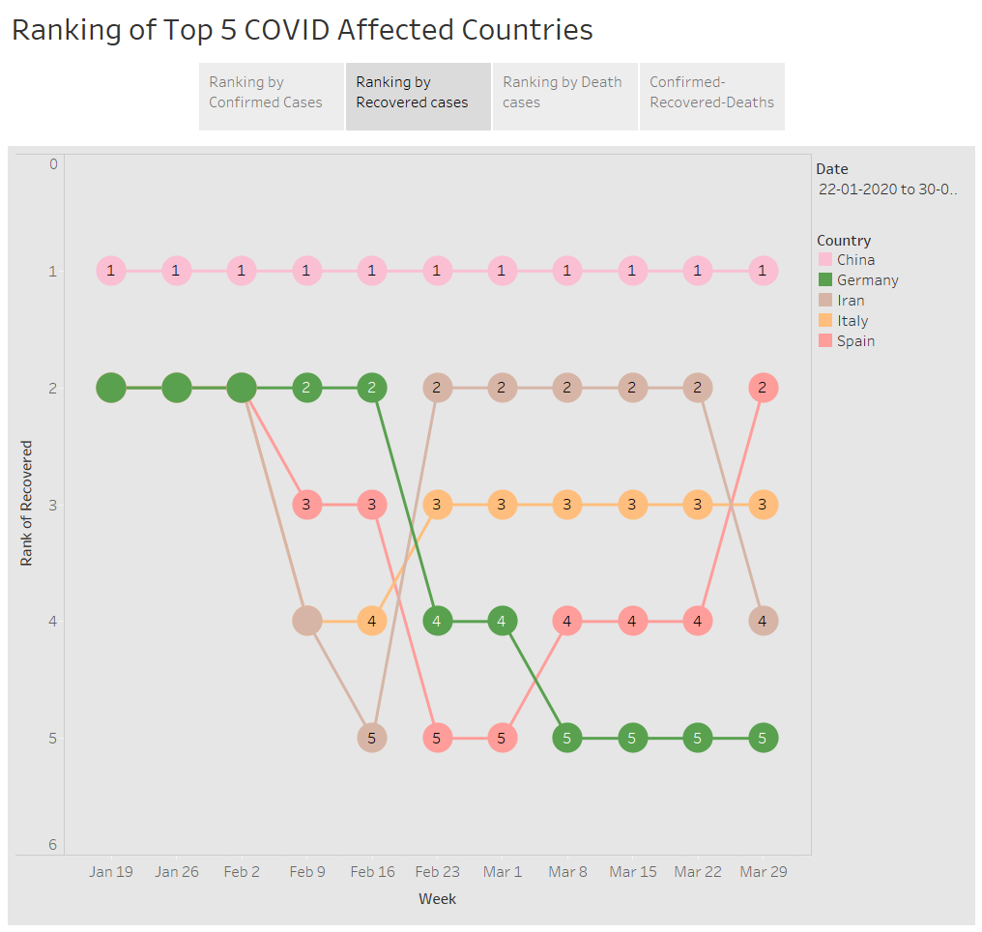

Slide 4
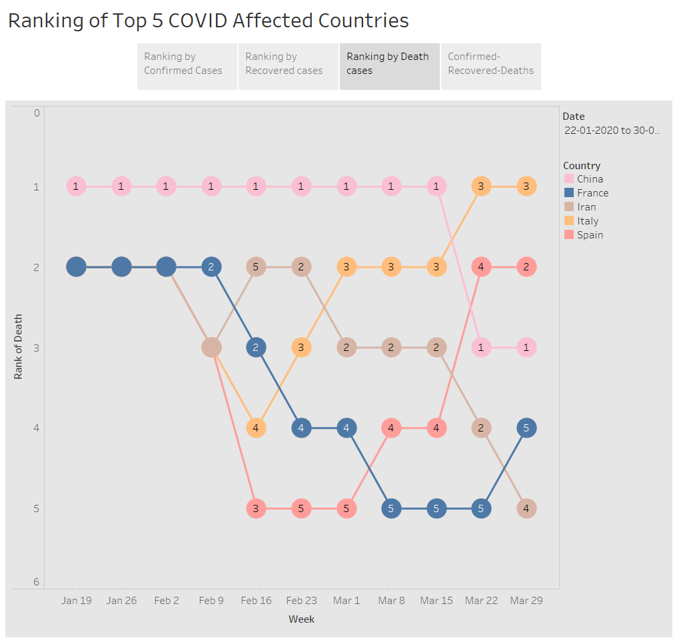

Slide 5
